Slide 1
Stanly County Comprehensive Transportation Plan (CTP) Overview
Temilope Animashaun, Roger Castillo
January 30, 2024

Slide 2
What is a CTP?
Anson County CTP
Comprehensive Transportation Plan
Long-range, multi-modal transportation plan
25 to 30 year planning period
Vision plan
Developed cooperatively among local stakeholders, Rural Planning Organization (RPO), and NCDOT
Incorporates Land Use plans, community & statewide goals

Slide 3
Where does the CTP fit into the “Big Picture”?
Anson County CTP
Long-Range Planning CTP
Determining the Need
North Carolina Prioritization Process
Project given a score for funding consideration
Program Development
Funding the Projects
Project Planning
Minimizing the Impacts
Project Design
Design & Right-of-Way (ROW)
Construction, Maintenance, Operations
Building & Maintaining the Road

Slide 4
Why is a CTP Needed?
Anson County CTP
§ G.S. 136-66.2 – Development of a coordinated transportation system and provisions for streets and highways in and around municipalities¹.
First Part of (a):
Each municipality, not located within a metropolitan planning organization (MPO) as recognized in G.S. 136-200.1, with the cooperation of the Department of Transportation, shall develop a comprehensive transportation plan that will serve present and anticipated travel demand in and around the municipality.
¹http://www.ncleg.net/EnactedLegislation/Statutes/HTML/BySection/Chapter_136/GS_136-66.2.html

Slide 5
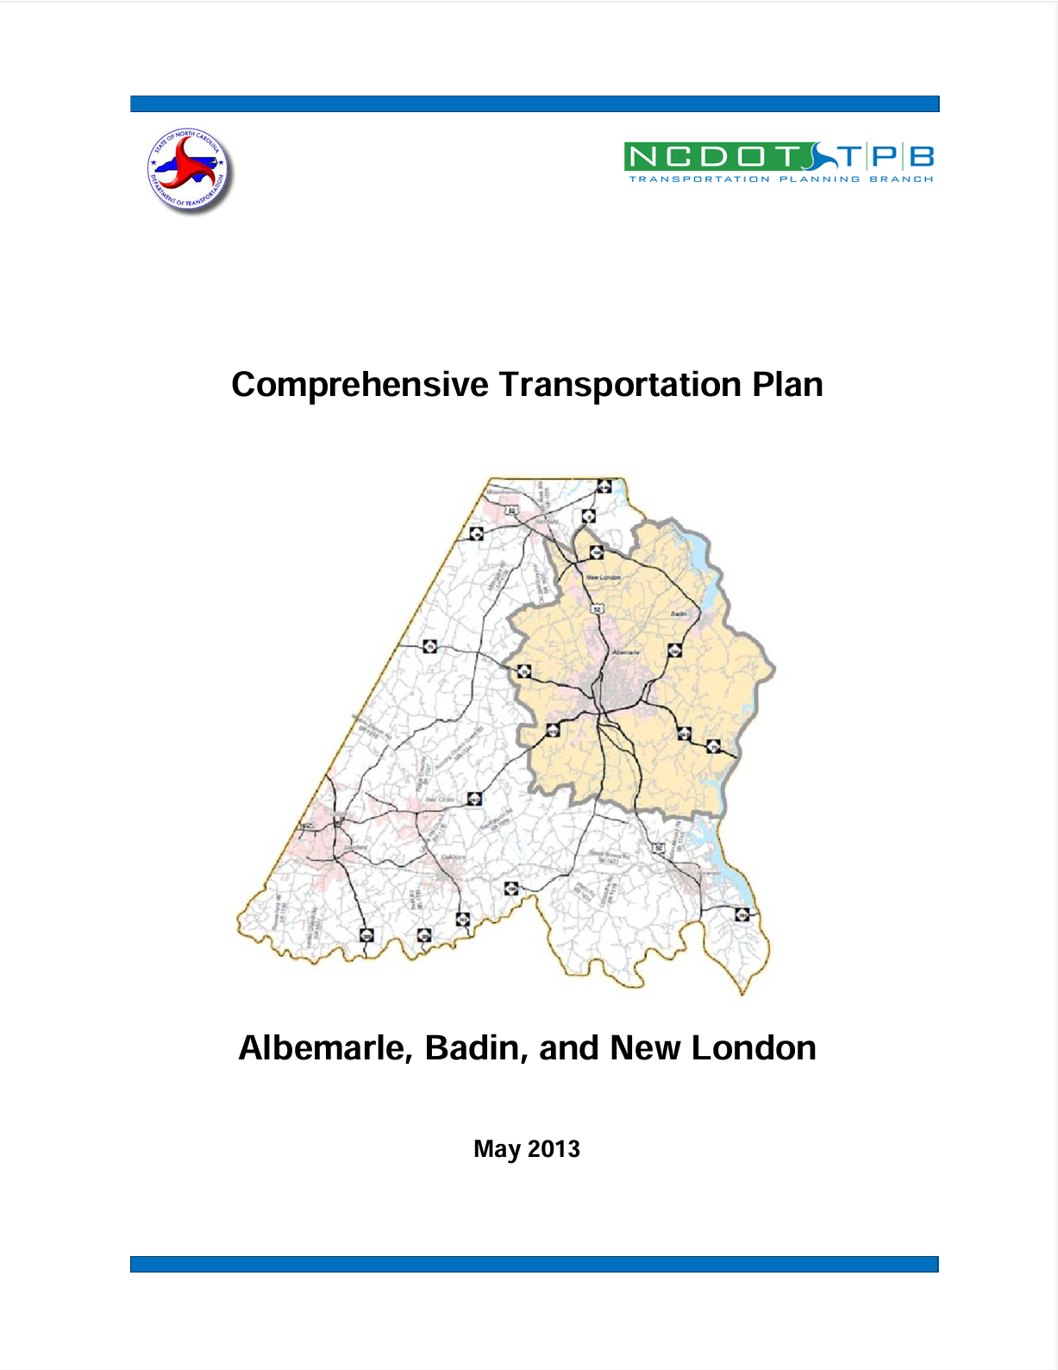
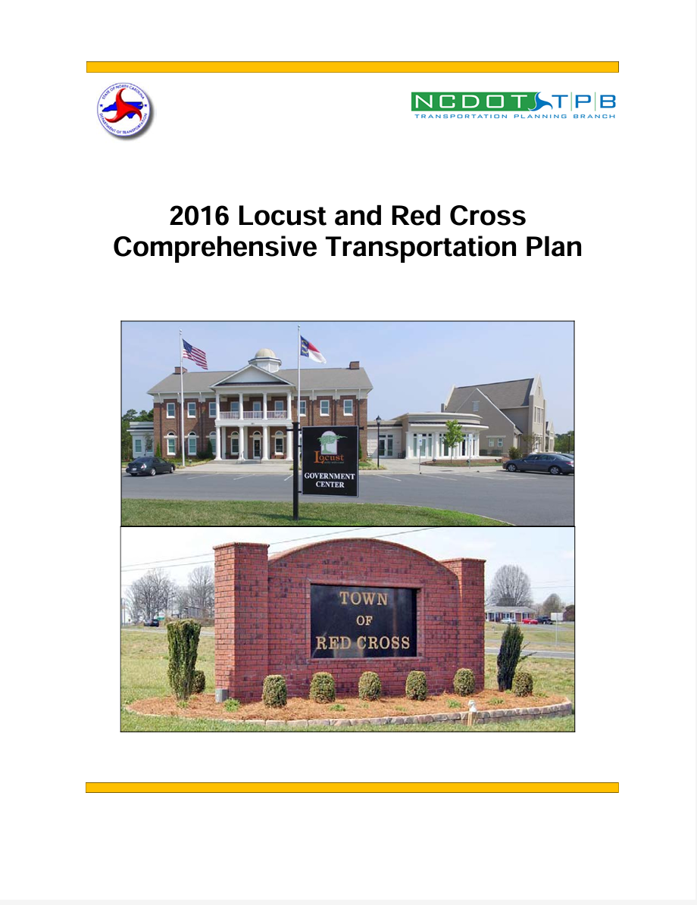
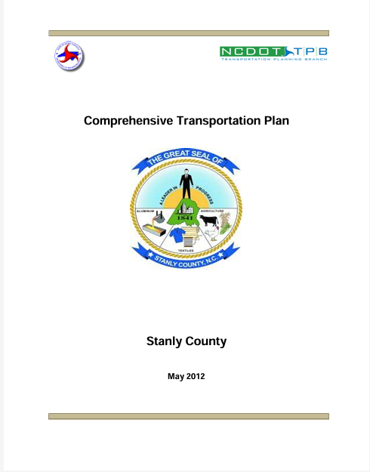
Stanly County
Anson County CTP

Slide 6
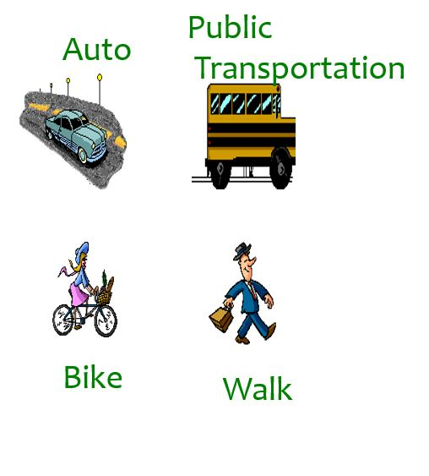
What is in a CTP?
Anson County CTP
Multimodal Maps
Highway
Public Transportation and Rail
Bicycle/Pedestrian
Current and Future Conditions
Lanes
Right-of-Way (ROW)
Volume and Capacity
Recommendations
Existing
Proposed

Slide 7
What are the Benefits of a CTP?
Anson County CTP
A transportation plan that is coordinated with the local growth plan
Results guide the RPO to submit projects to NCDOT for project consideration.
Common, long-range vision for facilities among local governments, RPO, and NCDOT
Notes:
It is coordinated effort
As mentioned before; recommendations help guide the RPO to submit projects for consideration
It is a common long range vision among various parties

Slide 8
CTP Steering Committee
Anson County CTP
Role
Represent stakeholders in the county
Coordinate with local councils and planning boards
Assist with public involvement
Review plan as it is developed
Assist with adoption and endorsement
Members
NCDOT – Transportation Planning Division and Division 10
RPO – Rocky River RPO
Local Stakeholders – County, towns, business interests, multi-modal reps, environmental interests, Title VI, schools, elderly, etc.
The Public

Slide 9
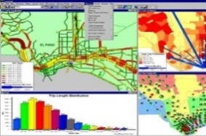
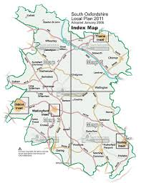
For All modes: Highway, Public Transportation, Bicycle & Pedestrian, Rail & Freight
Develop Vision
System Assessment
Analyze Alternatives
Develop
Draft Plan
Adopt
Plan
Latest Planning Assumptions
Community Understanding
Validate
Vision
Public Involvement

Slide 10
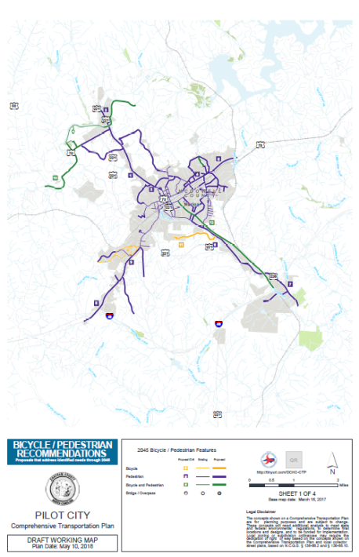
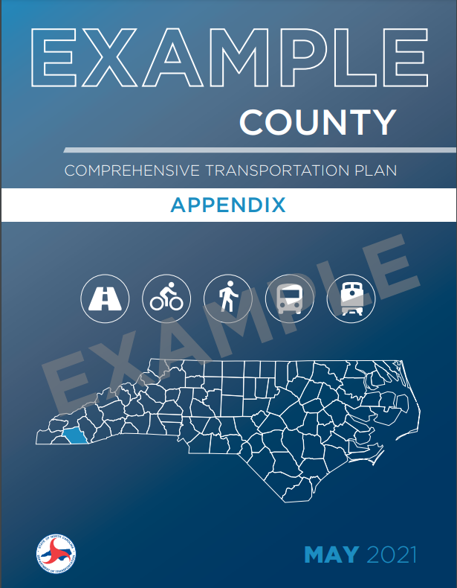
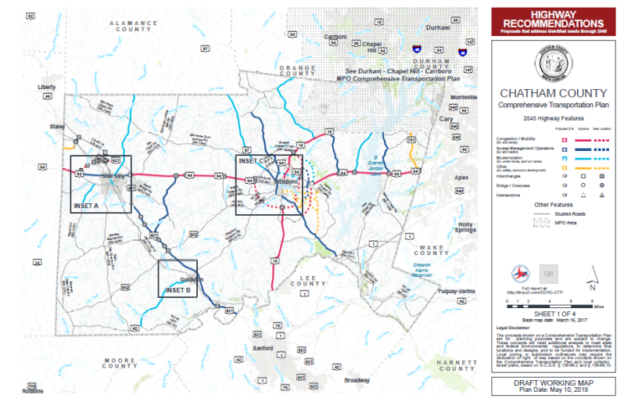
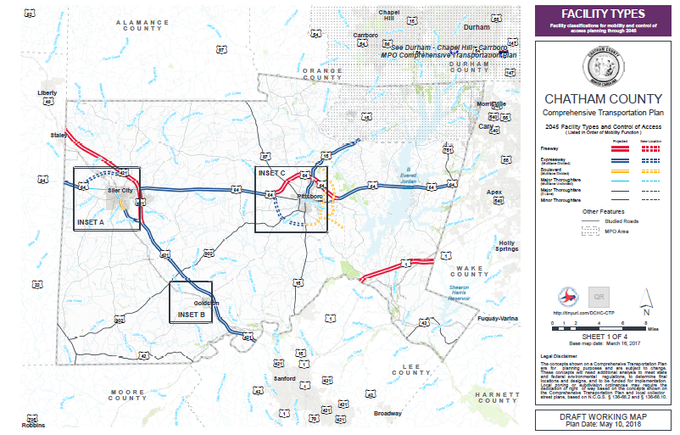
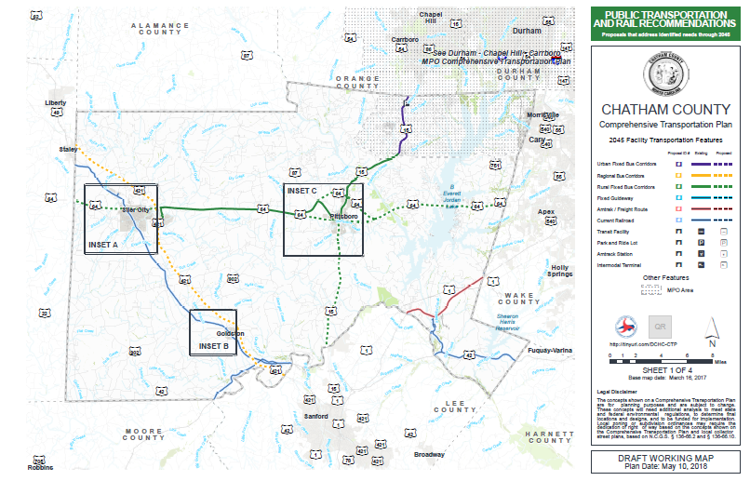
Plan Documentation

Slide 11
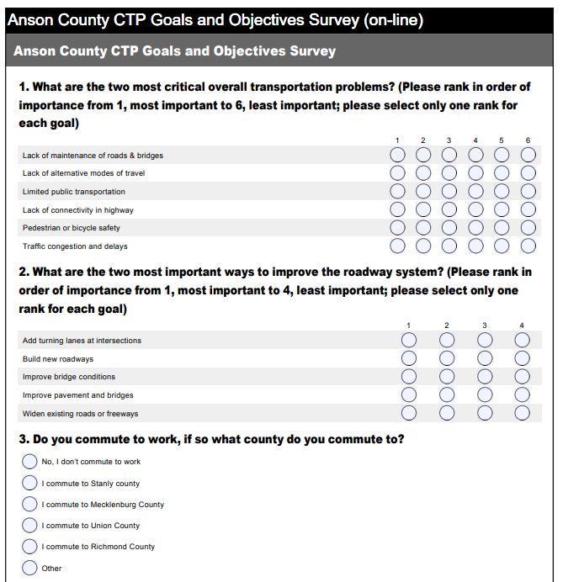
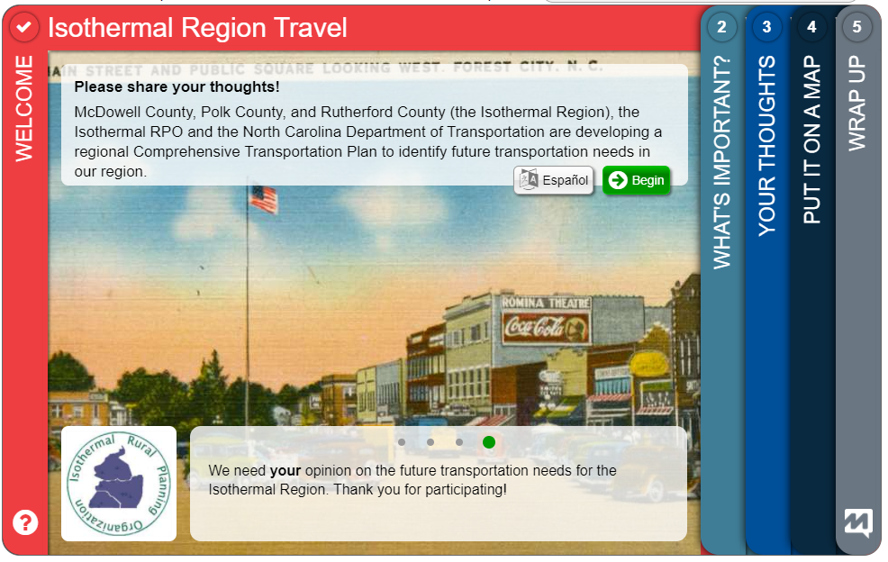
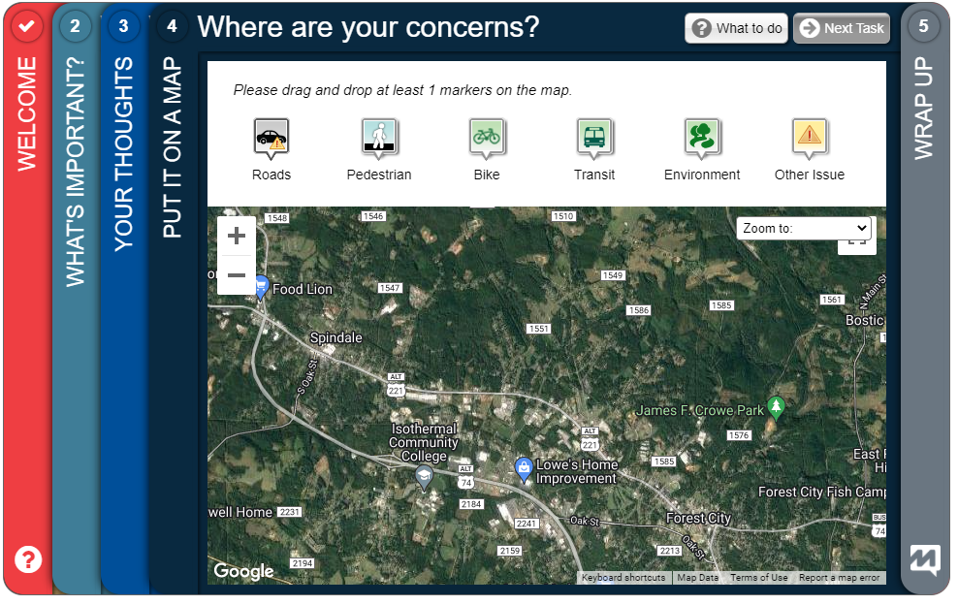
Public Involvement
Community Vision, Goals, and Objectives
Example: https://isothermalctp-demo.metroquest.com/

Slide 12
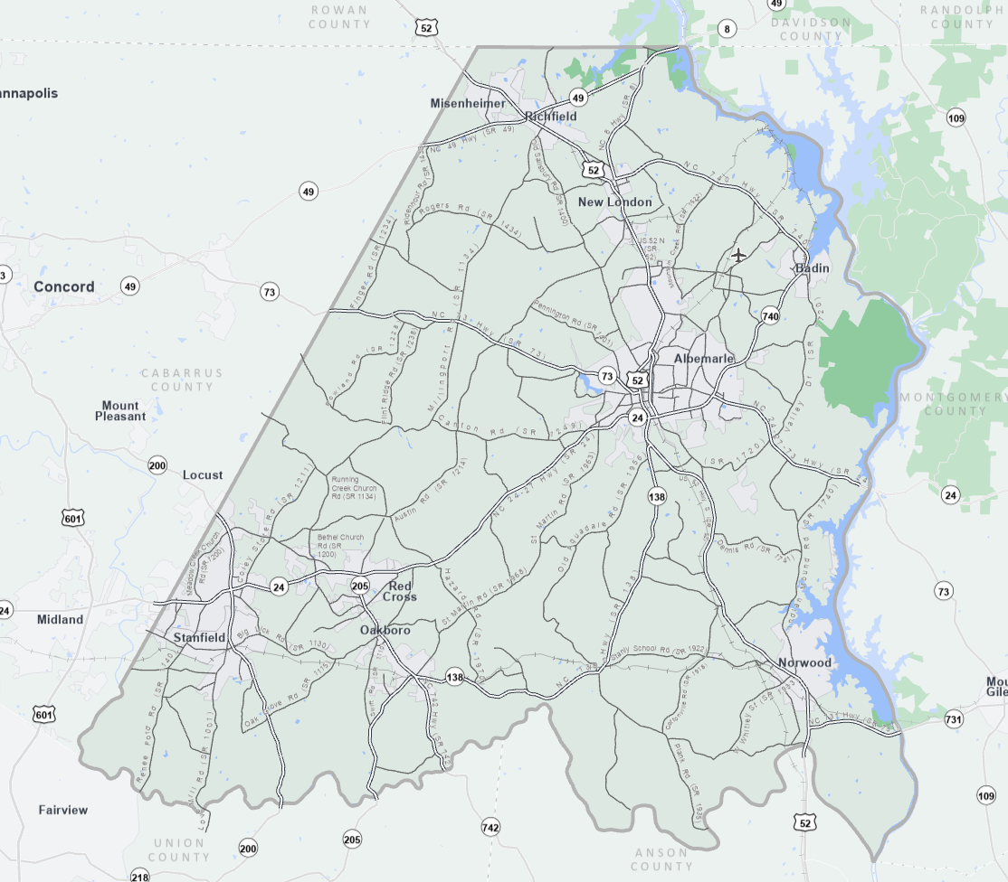
Identification of Studied Roads
Major Roadways
Highly Frequented Roads
Facilities that go through multiple municipalities
Important connectors

Slide 13
Contacts
Anson County CTP
NCDOT Transportation Planning Division (TPD)
Temilope Animashaun, tmanimashaun@ncdot.gov, (919)-707-0931 (Project Engineer)
Roger Castillo, ricastillo@ncdot.gov, (919) 707-0942 (Project Engineer)
Rocky River Rural Planning Organization (RPO)
Lee Snuggs, lsnuggs@rockyriverrpo.org, (704) 986-3871

Slide 14
QUESTIONS

